Slide 1

Anonymous Company Case Study
by: Justin Gill

Slide 2
Company XYZ Background
Company XYZ is a video streaming company that publishes videos to their own website.
The videos are presented to users on the home page in different spots of exposure that can be considered to be:
Hot
Stable and Popular
Everything Else

Slide 3

Company XYZ’s home page drop off rate
Currently, the company experiences a problem of users visiting the home page, but not interacting with any videos.
Therefore, since customer acquisition costs are very high, the company is not generating revenue from these non-active users.

Slide 4
Proposed Recommended Video Section
The current home page has manually chosen videos shown to the user, therefore not allowing the user to see videos they’re more likely to watch.
The Head of Product proposes creating a new recommended video section for the home page which would help users be more inclined to interact with videos.
This would allow uploaded videos that are classified as being hot to be recommended to the user upon visiting the home page.

Slide 5
Features used to classify each video
We can describe our videos using different features to help classify which ones are going to be considered hot and placed in the recommended section.
These features are given as:
View Count
Length
Video Language
Video Quality
Upload Date

Slide 6
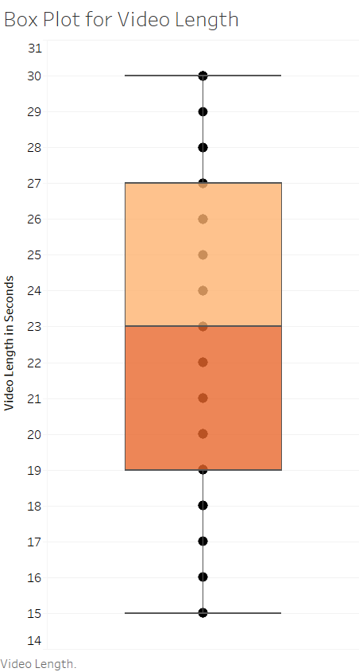
Videos under 30 seconds
The box plot tells us our video lengths have almost even tails and a mean that is centered.
Therefore, we know our videos tend to be, on average, 23 seconds long.
Our shortest video is 15 seconds, while are longest is 30 seconds.

Slide 7
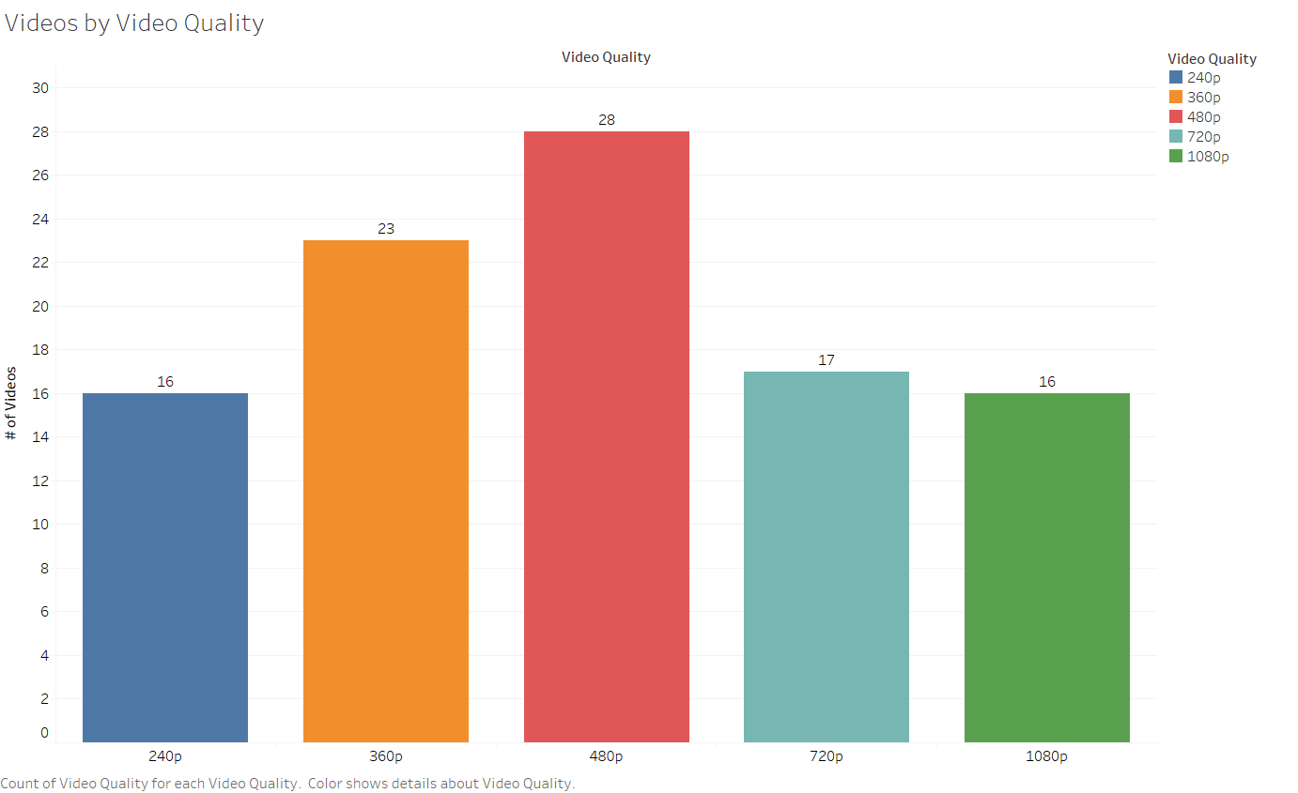
Lower quality videos
The videos are uploaded at different qualities ranging from 240p - 1080p.
We can see that lower quality videos tend to be more common, with only a third of the videos being 720p or 1080p.

Slide 8
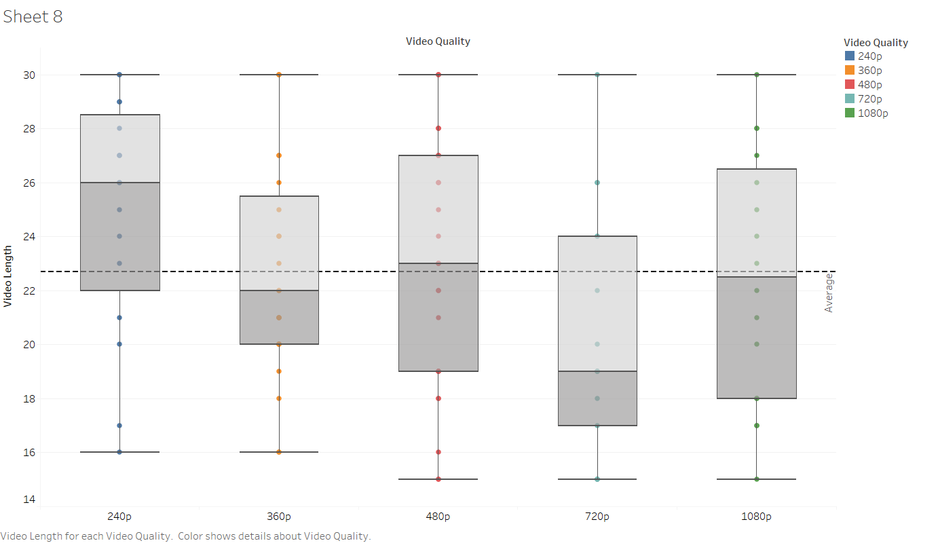
Varying quality and lengths
The traditional boxplot has now been split by video qualities, we can now look at video length relationships.
The boxplots are plotted with the average line, we can see that 720p videos are shorter videos on average, whereas 240p videos are much longer on average.

Slide 9
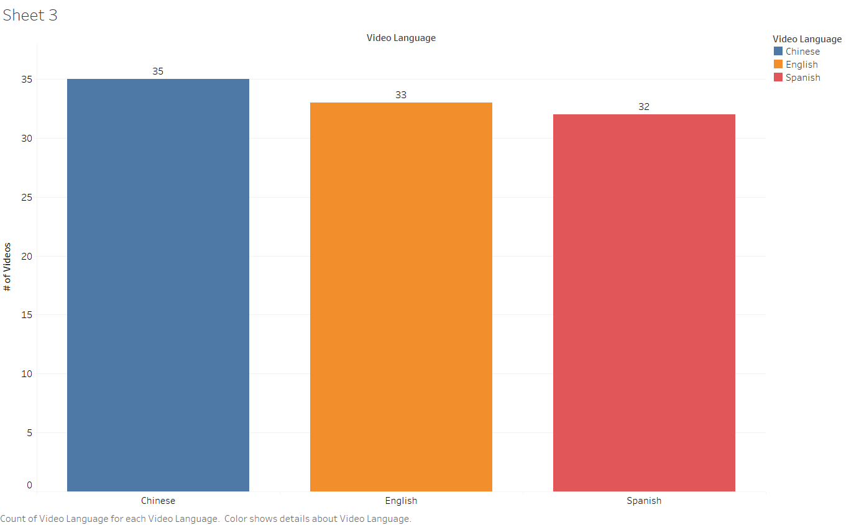
Diversity in language
The languages in the videos currently are Chinese, Spanish and English.
The videos are distributed fairly evenly, with slightly more videos being Chinese rather than English or Spanish.

Slide 10
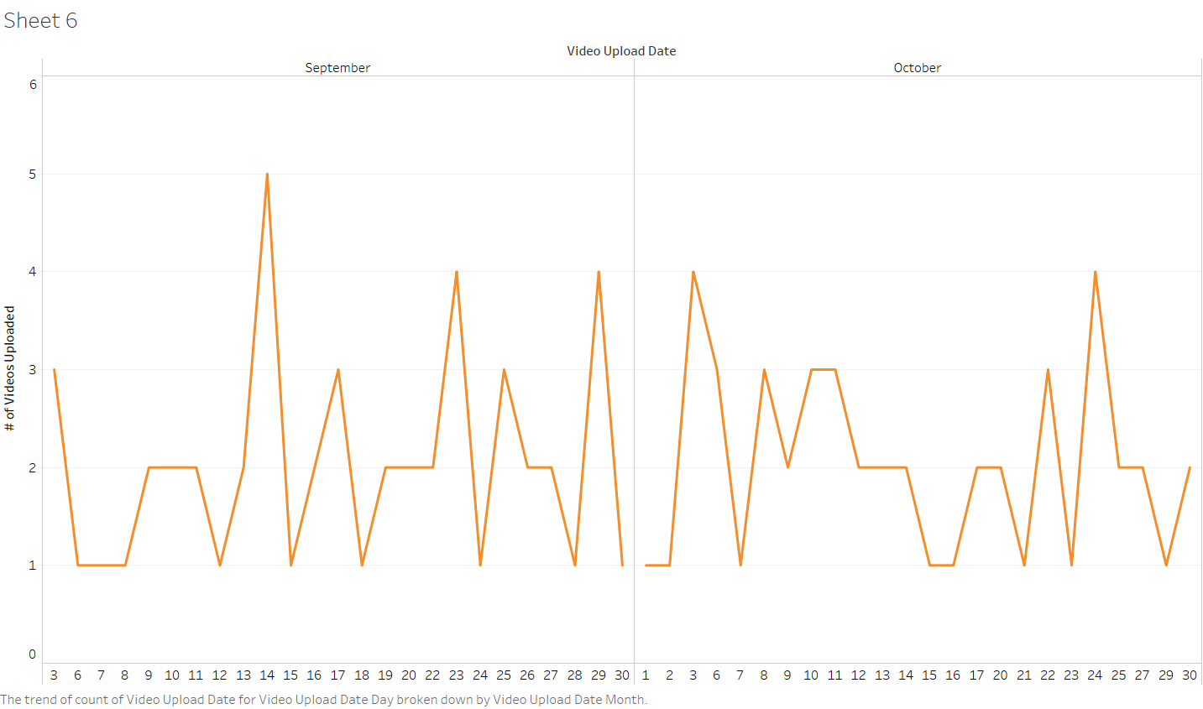
Erratic uploads
The time series plotted shows the amount of videos uploaded on a particular date.
The plot shows us that our video uploads do not have a clear trend and seem to be rather unpredictable.

Slide 11
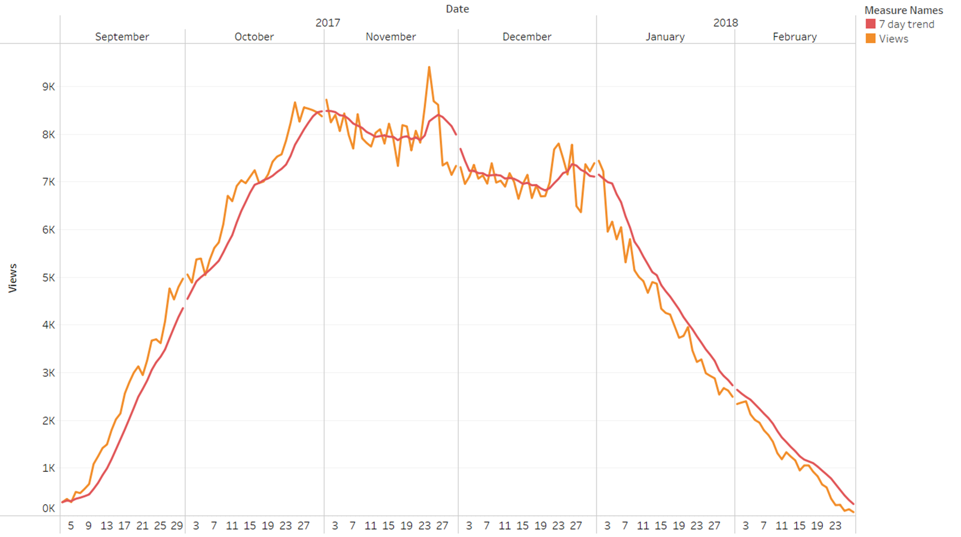
Viewers on sharp decline
This time series plot shows us the viewer count each day on the website.
We notice that there was a sharp increase leading to a very noticeable spike around Thanksgiving in viewers.
After the first spike, viewers decline followed by two more noticeable spikes around Christmas and New Years and another steady downward trend in viewers.

Slide 12
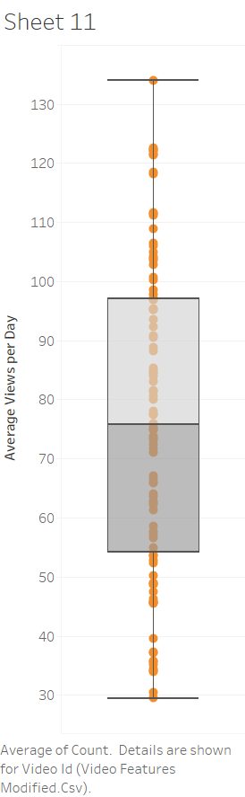
Metric of average views
This boxplot shows the average views per day a particular video gets.
This is intuitively a good metric for performance of our videos since we are interested in video activity from users.
This shows that the average views per day a video gets is 76 views.
The highest average views is 133 views, whereas the minimum is 29 views per day.

Slide 13
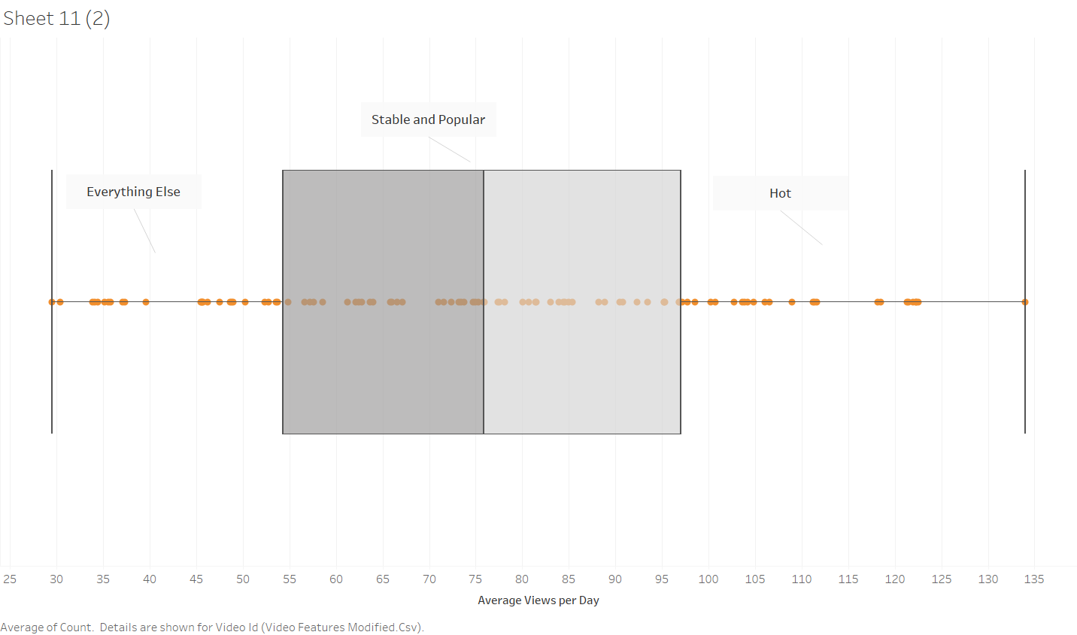
Hot video or not
Classification of hot, stable and popular and everything else videos will be represented by the first, second to third and fourth quantiles shown above since average views is our performance metric.

Slide 14
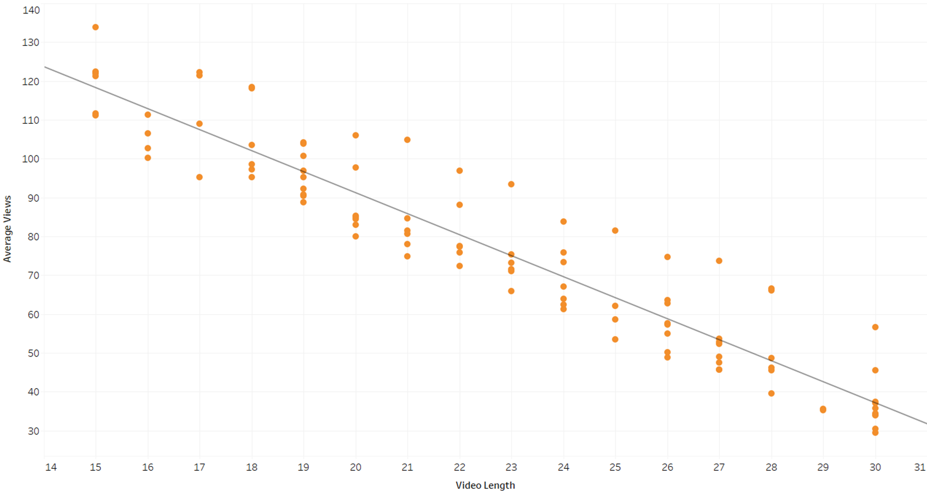
Less time, more views
Given that we have decided on average views as a metric of performance for the videos, we can now explore relationships of average views.
The line here show that the longer your video is the less likely it will to be watched.
You can expect to lose approximately 5.5 views/second of video.

Slide 15
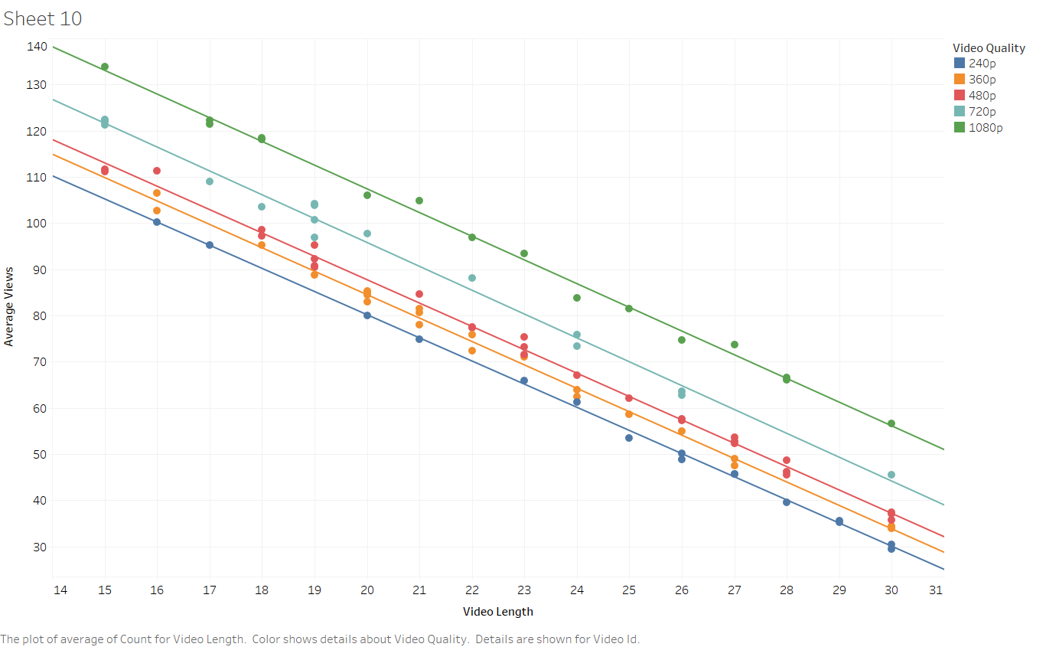
Quality matters too
Exploring average views and video length again, the data is then split by the category of video quality.
A negative relationship exists between average views and video length, but the graph indicates that video quality is related to average views also!
Furthermore, the plot shows no matter what the length of the video is, a higher quality video will get more views.

Slide 16
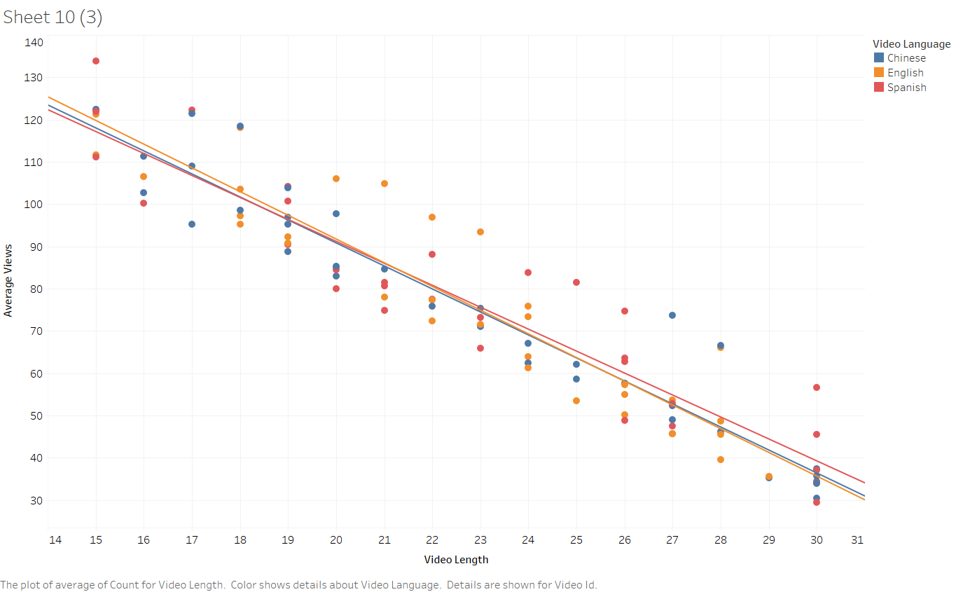
Language not so much
The plot here is looking at the relationship between average views and video length, but is now split by video language.
The grouping by language does not seem to separate the data as clearly as quality did.
Therefore, language of the video does not seem to be of strong importance to a video being hot.

Slide 17
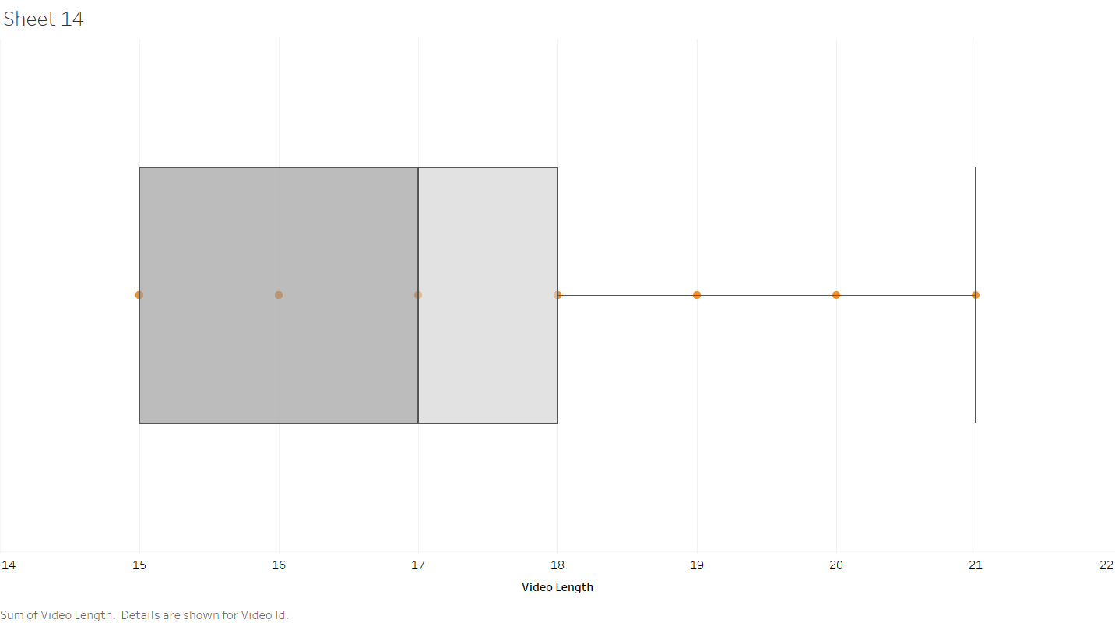
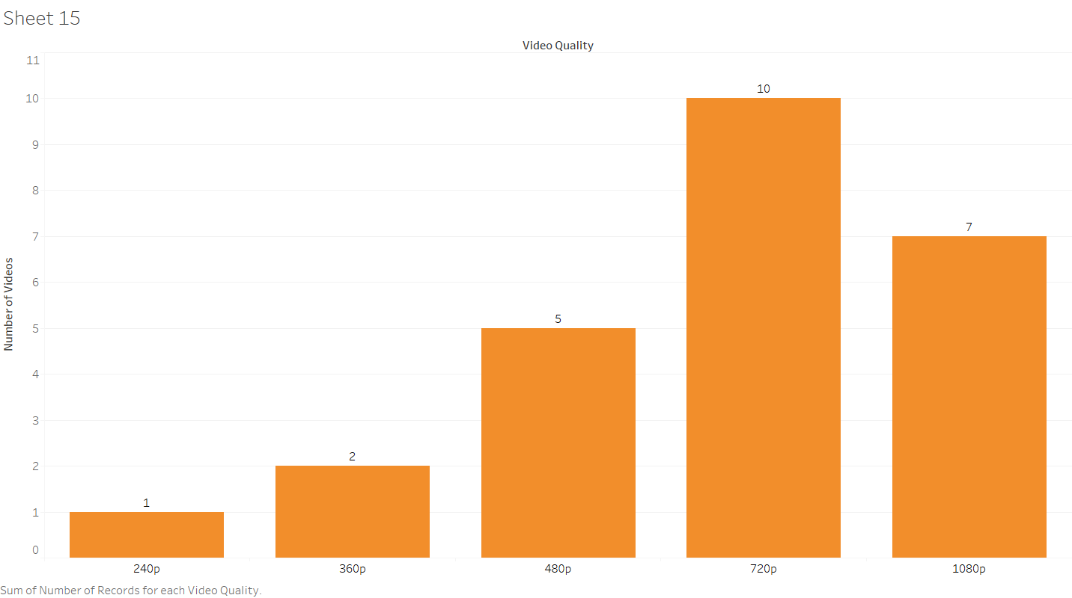
Short and high quality videos
Through looking at the video features of hot videos, the data presents a case that hot videos are classified mostly by being a shorter video and having higher quality.
The previous charts and plots have also supported this argument.

Slide 18
Recommend shorter videos of higher quality
Given our metric of average views, the relationship of the length of a video and it’s quality, the website can now be equipped to recommend more relevant videos.
Currently, the website has a good majority of 240p and 360p videos uploaded. The website should focus more on recommending videos that are of higher quality.
Moreover, the longer the video is the less likely it is to be watched, so focus should also be put on recommending shorter videos. The current average is 23 seconds, therefore I would try to keep videos below 23 seconds.

